Slide 1
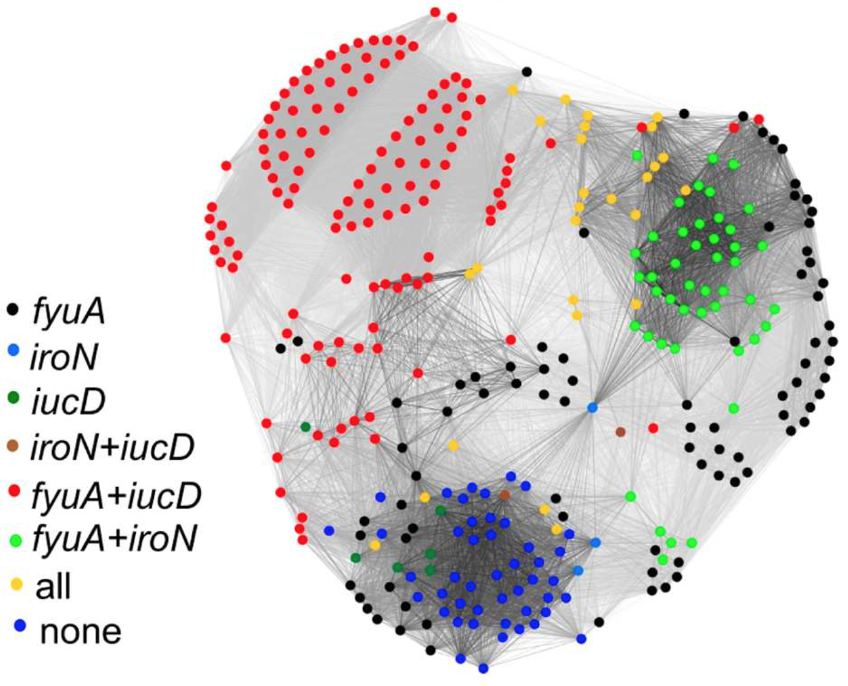
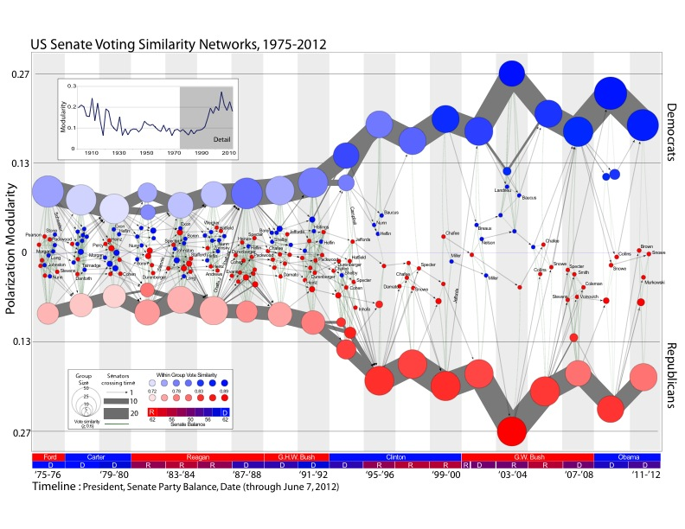
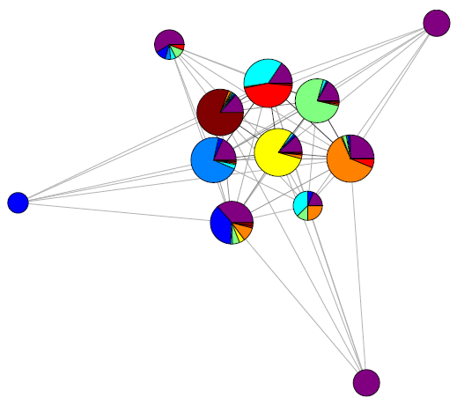
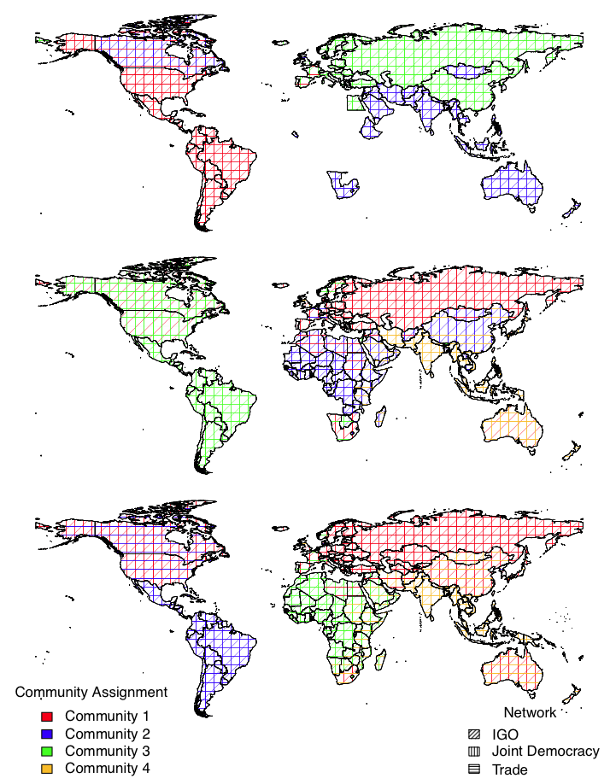
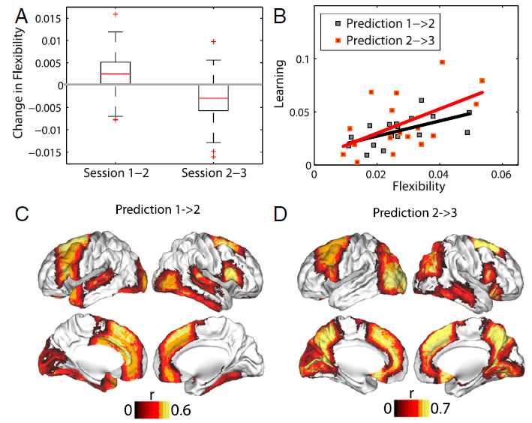
Communities in Networks Peter J. Mucha, UNC–Chapel Hill

Slide 2
Outline & Acknowledgements
What is community detection and why is it useful?
How do you calculate communities?
Software links
Importance of resolution parameters
Multilayer networks
If time permits (I’ll leave you slides)
Skyler Cranmer, James Fowler, Jeff Henderson, Jim Moody, J.-P. Onnela, Mason Porter
Dani Bassett, Kaveri Chaturvedi, Saray Shai, Dane Taylor
Natalie Stanley, Mandi Traud, Andrew Waugh, William Weir, James Wilson
Scott Emmons, Ryan Gibson, Eric Kelsic, Kevin Macon, Thomas Richardson
JSMF, UCRF (UNC), ARO, CDC, NICHD, NIDDK, NIGMS, NSF
Apologies that this presentation will seriously err on the self-absorbed side.
It’s a big field, and I do not promise to cover even a small piece of it here.

Slide 3
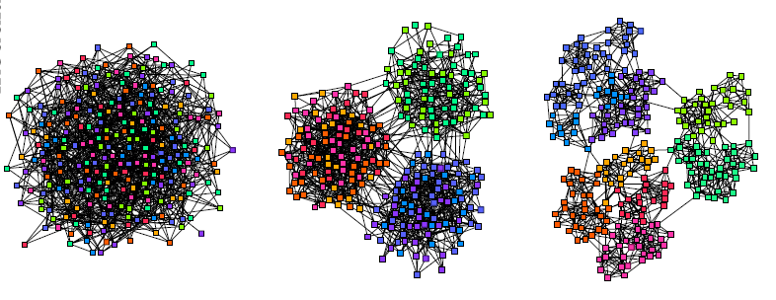
Philosophical Disclaimer
Jim Moody (paraphrased): “I’ve been accused of turning everything into a network.”
PJM (in response): “I’m accused of turning everything into a network and a graph partitioning problem.”
“Structure ←→ Function”
Images by Aaron Clauset

Slide 4
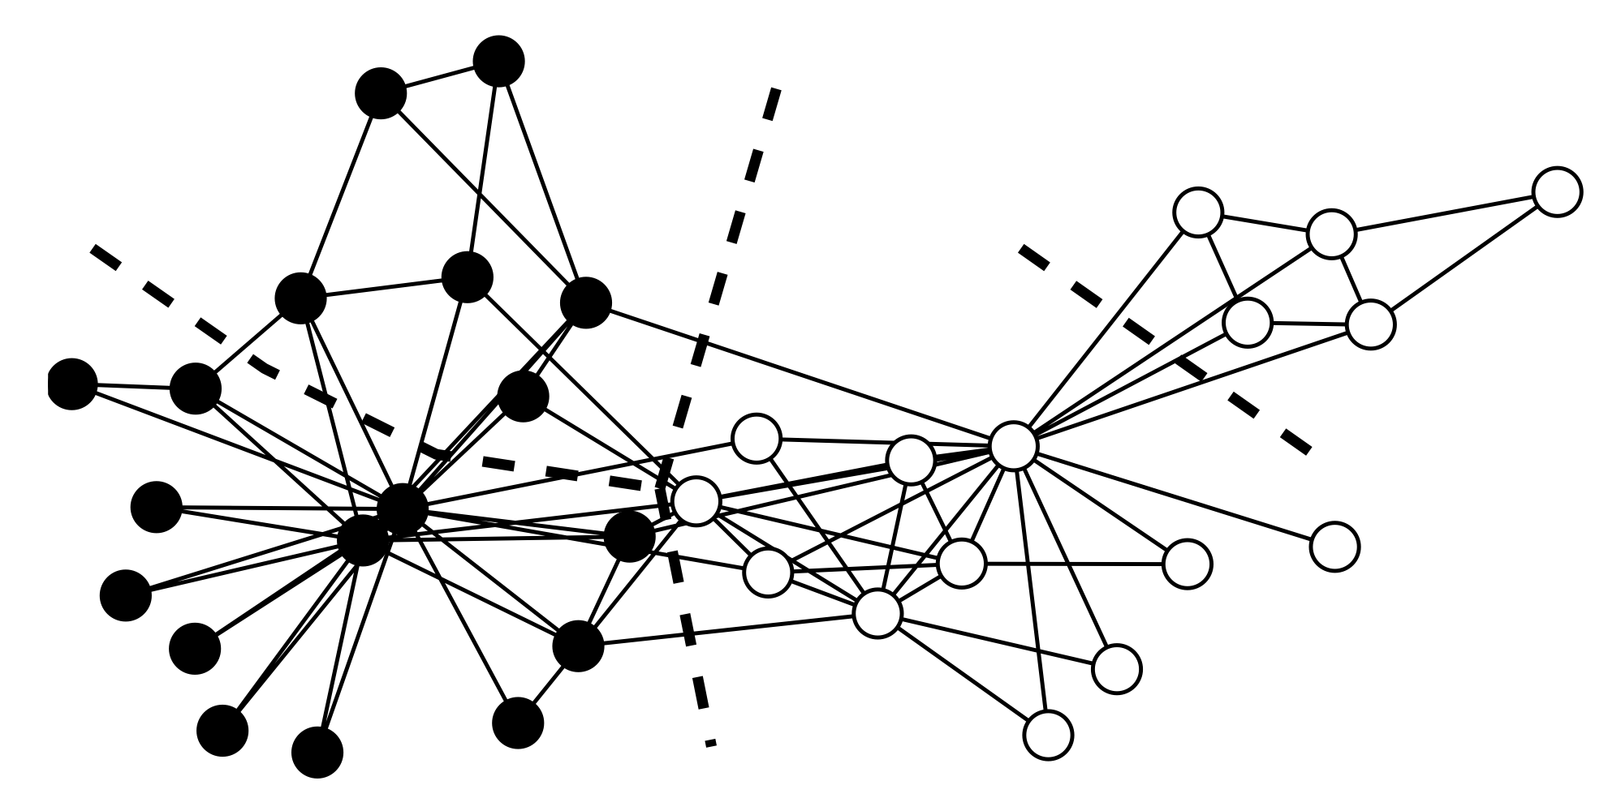
Karate Club Example
This partition optimizes modularity, which measures the number of intra-community ties (relative to a random model)
“If your method doesn’t work on this network, then go home.”

Slide 5

Karate Club Club
“Cris Moore (left) is the inaugural recipient of the Zachary Karate Club Club prize, awarded on behalf of the community by Aric Hagberg (right). (9 May 2013)”

Slide 6
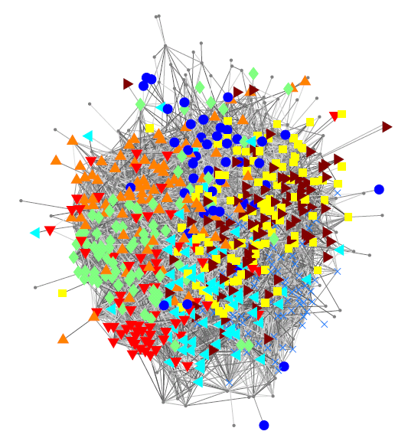
Facebook Traud et al., “Comparing community structure to characteristics in online collegiate social networks” (2011) Traud et al., “Social structure of Facebook networks” (2012)
Caltech 2005: Colors indicate residential “House” affiliations Purple = Not provided

Slide 7
Facebook Traud et al., “Comparing community structure to characteristics in online collegiate social networks” (2011) Traud et al., “Social structure of Facebook networks” (2012)
Caltech 2005: Colors indicate residential “House” affiliations

Slide 8
Facebook Traud et al., “Comparing community structure to characteristics in online collegiate social networks” (2011) Traud et al., “Social structure of Facebook networks” (2012)
Caltech 2005: Colors indicate residential “House” affiliations Purple = Not provided

Slide 9
Community Detection Firehose Overview
“Hard/rigid” v. “soft/overlapping” clusters
cf. biclustering methods and mathematics of expander graphs
A community should describe a “cohesive group”: varying formulations/algorithms
Linkage clustering (average, single), local clustering coefficients, betweeness (geodesic, random walk), spectral, conductance,…
Classic approach in CS: Spectral Graph Partitioning
Need to specify number of communities sought
Conductance
MDL, Infomap, OSLOM, … (many other things I’ve missed) …
Stochastic Block Models: generative with in/out probabilities between labeled groups
Modularity: a good partition has more total intra-community edge weight than one would expect at random (but according to what model?)
“Communities in Networks,” M. A. Porter, J.-P. Onnela & P. J. Mucha,
Notices of the American Mathematical Society 56, 1082-97 & 1164-6 (2009).
“Community Detection in Graphs,” S. Fortunato, Physics Reports 486, 75-174 (2010).
“Community detection in networks: A user guide,” S. Fortunato & D. Hric, Physics Reports 659, 1-44 (2016).
“Case studies in network community detection,” S. Shai, N. Stanley, C. Granell, D. Taylor & P. J. Mucha, arXiv:1705.02305.

Slide 10
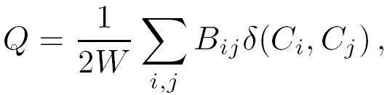
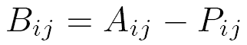
Modularity (see Newman & Girvan and other Newman papers)
Your data:
Edge from i to j?
Total edge
weight
Indicator on
nodes i & j in
same community
Random “null model”
for expected edge weight
Modularity
matrix

Slide 11
Modularity (see Newman & Girvan and other Newman papers)
GOAL: Assign nodes to communities in order to maximize quality function Q
NP-Complete [Brandes et al. 2008] ~ enumerate possible partitions
Numerous packages developed/developing
e.g. igraph library (R, python), NetworkX, Louvain
Need appropriate null model

Slide 12
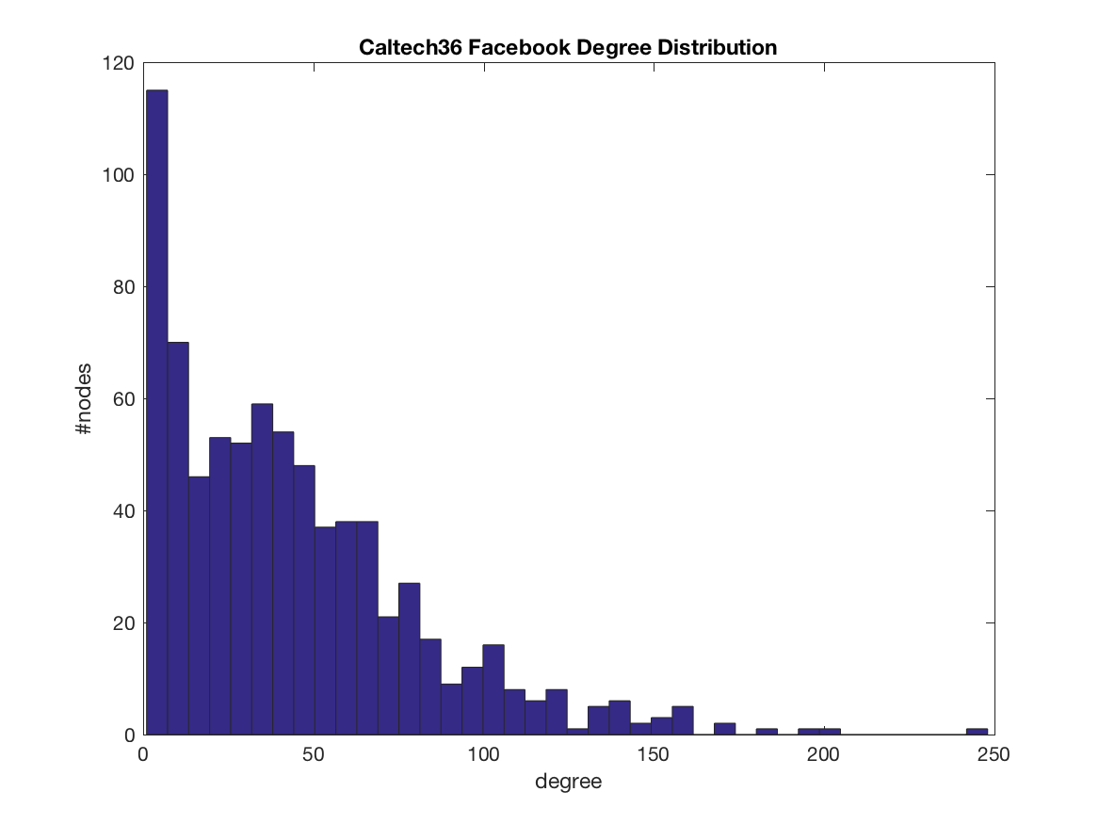
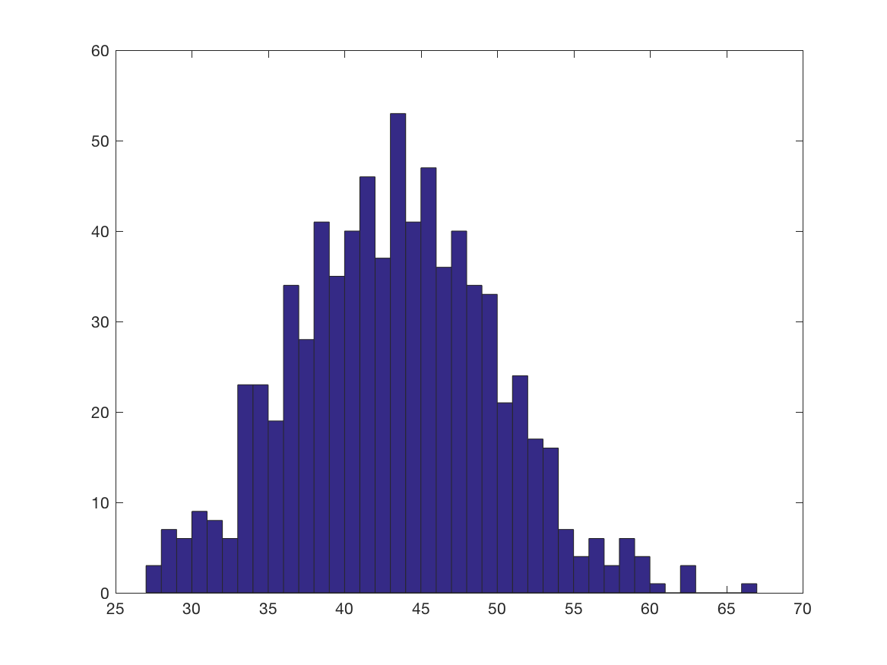
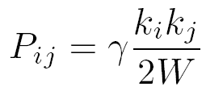
Modularity (see Newman & Girvan and other Newman papers)
ER degree distribution (binomial/Poisson) is not a good model for many real-world data sets
Independent edges, constrained to expected degree sequence same as observed.
Requires P_{ij} = f(k_{i})f(k_{j}), quickly yielding
γ resolution parameter ad hoc (default = 1) [Reichardt & Bornholdt, 2006; Lambiotte et al., 2008 & 2015]

Slide 13
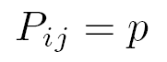
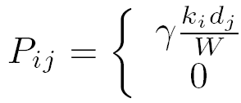
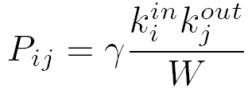
Null Models for Modularity Quality Functions
Erdős–Rényi (Bernoulli)
Newman-Girvan*
Leicht-Newman* (directed)
Barber* (bipartite)

Slide 14
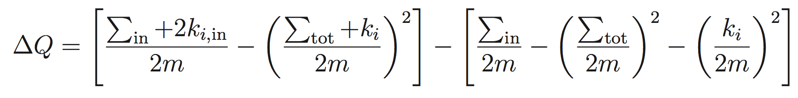
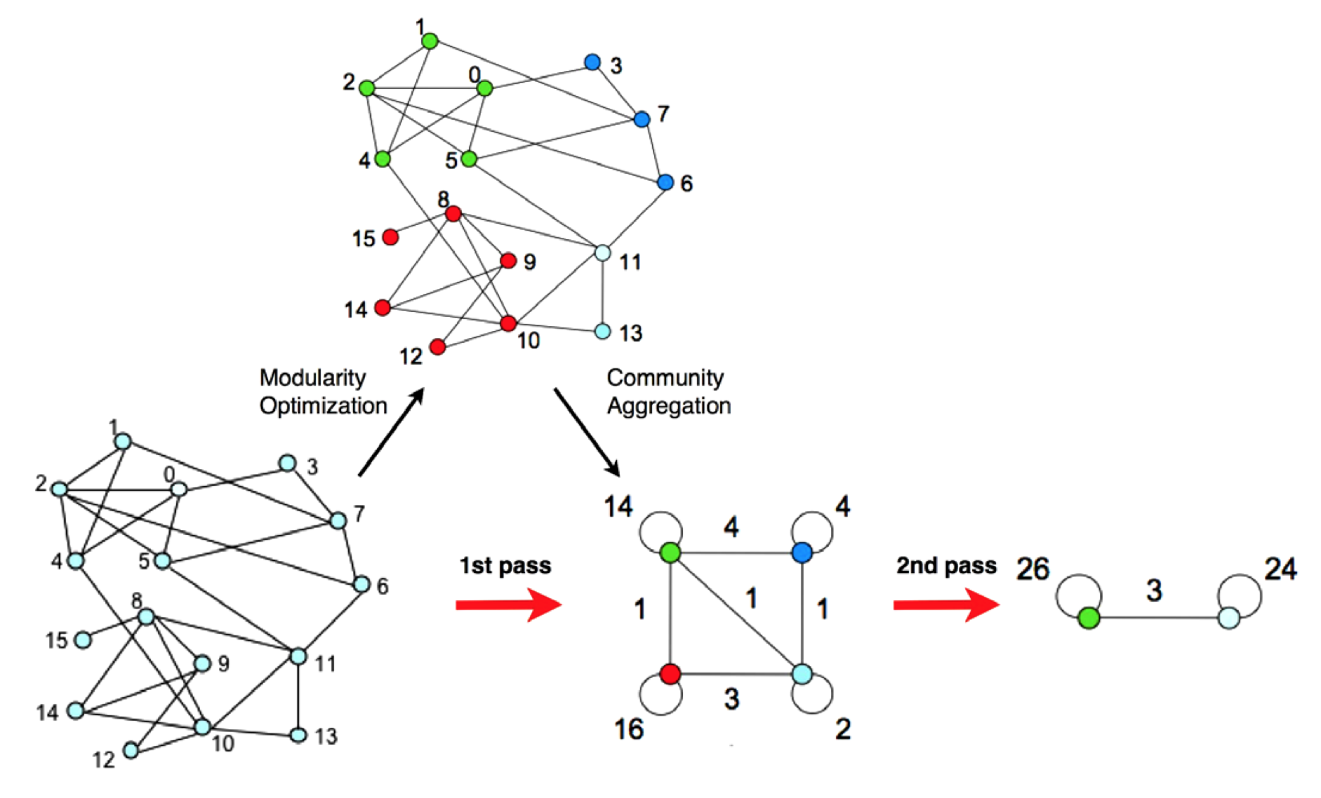
Louvain Method (Blondel et al., “Fast unfolding of communities in large networks”, 2008)

Slide 15
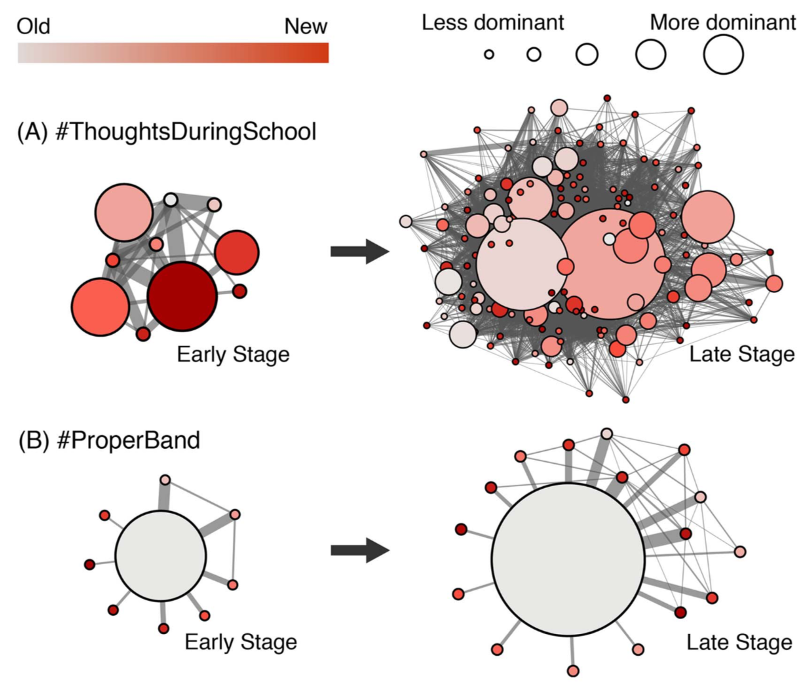
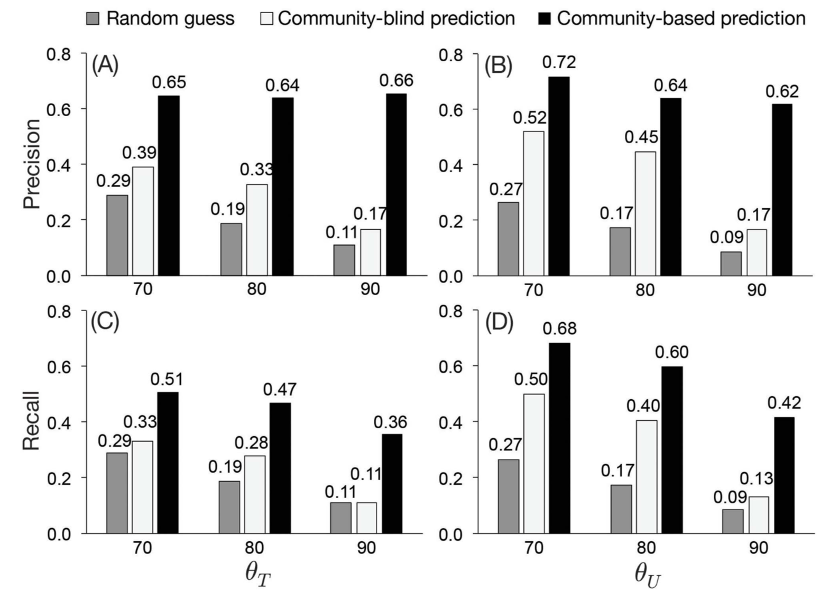
“Virality Prediction and Community Structure in Social Networks”, Weng, Menczer & Ahn (2013)

Slide 16
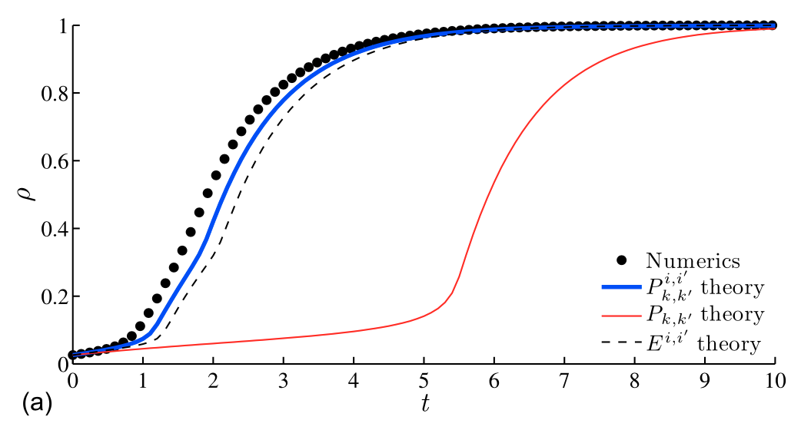
Melnik et al., “Dynamics on modular networks with heterogeneous correlations” (2014)
Fraction of active nodes Watts threshold model
Multi-university Facebook network

Slide 17
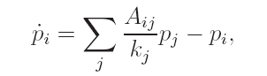
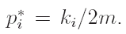
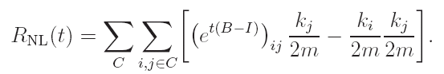
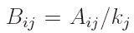
Modularity from Laplacian Dynamics
Lambiotte, Delvenne & Barahona [arXiv:0812.1770] showed a way to derive modularity from normalized Laplacian dynamics, defining partition quality in terms of stability (autocovariance in Markov process)
Expansion of matrix exponential to first-order in t recovers Newman-Girvan modularity with resolution γ = 1/t.
(This is going to be important again for multilayer networks)

Slide 18
U.S. Congressional Roll Call as a similarity network Waugh et al., “Party polarization in Congress: a network science approach” (2009)
85th Senate
Adjacency matrix of similarities is dense and weighted, cf. other typical networks (see committees: weighted but sparse)

Slide 19
U.S. Congressional Roll Call as a similarity network Waugh et al., “Party polarization in Congress: a network science approach” (2009)
85th Senate
108th Senate

Slide 20
Moody & Mucha, “Portrait of political party polarization” (2013)

Slide 21
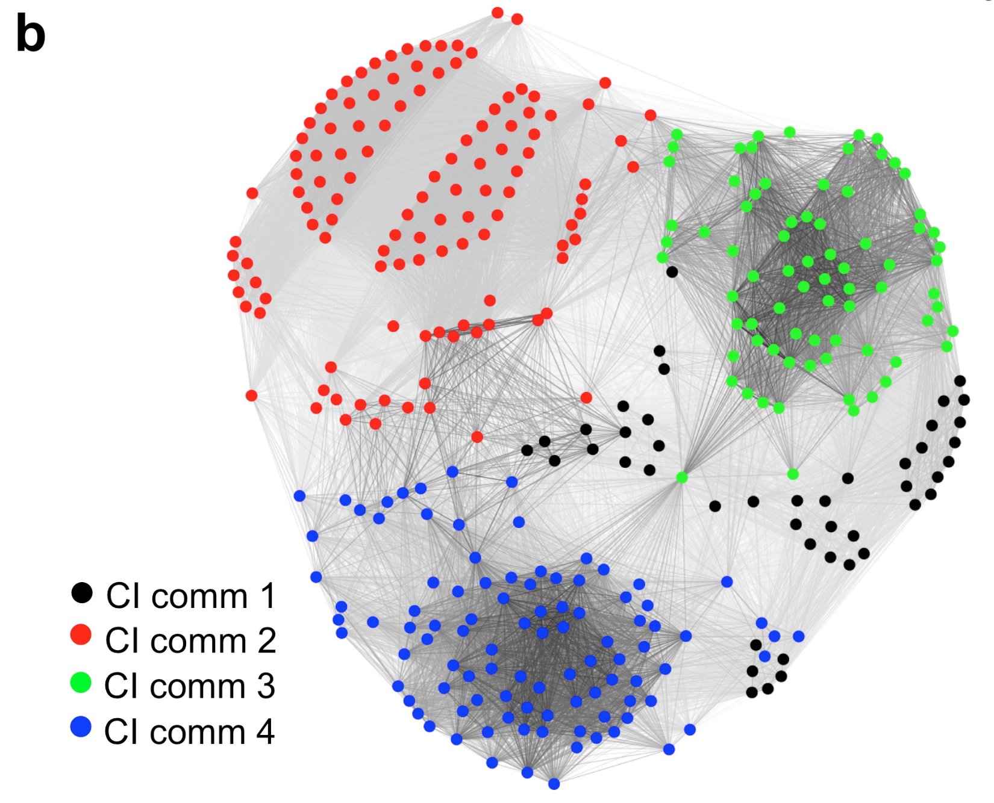
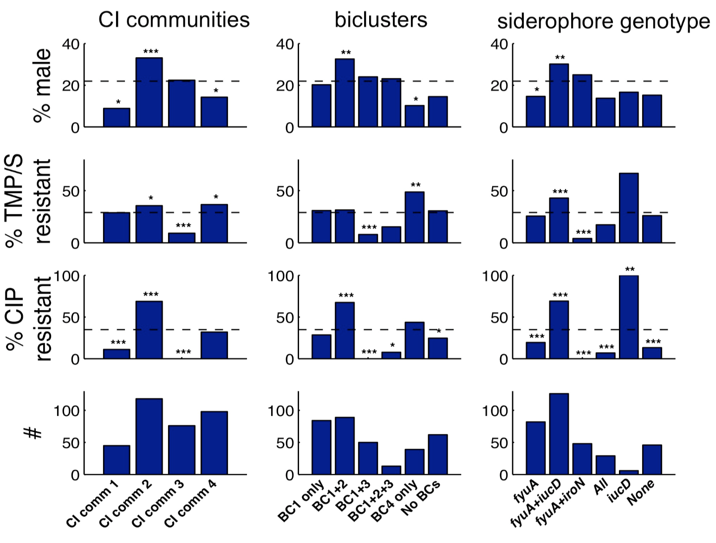
Parker et al., “Network Analysis Reveals Sex- and Antibiotic Resistance-Associated Antivirulence Targets in Clinical Uropathogens” (2015)

Slide 22
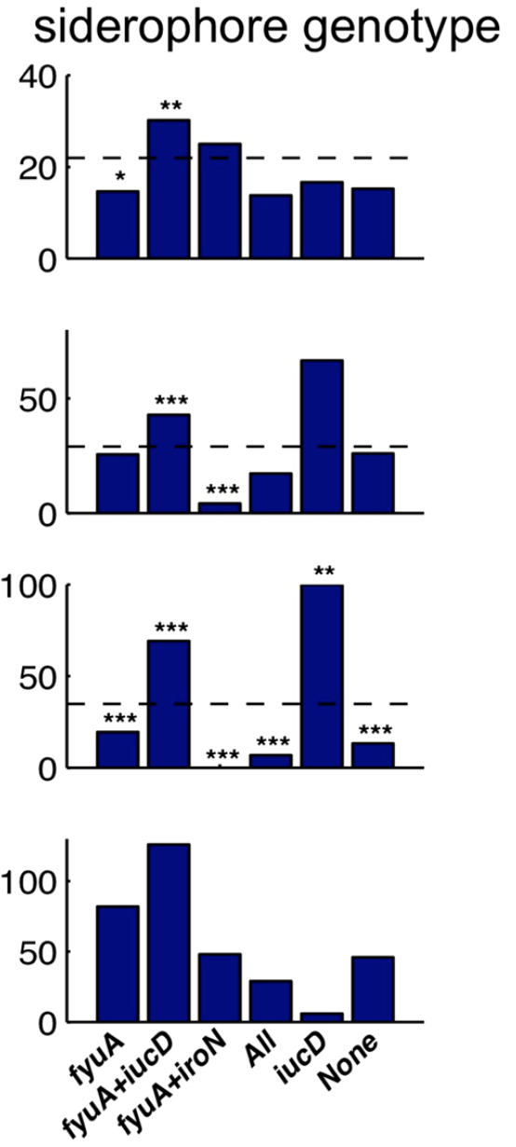
Parker et al., “Network Analysis Reveals Sex- and Antibiotic Resistance-Associated Antivirulence Targets in Clinical Uropathogens” (2015)

Slide 23
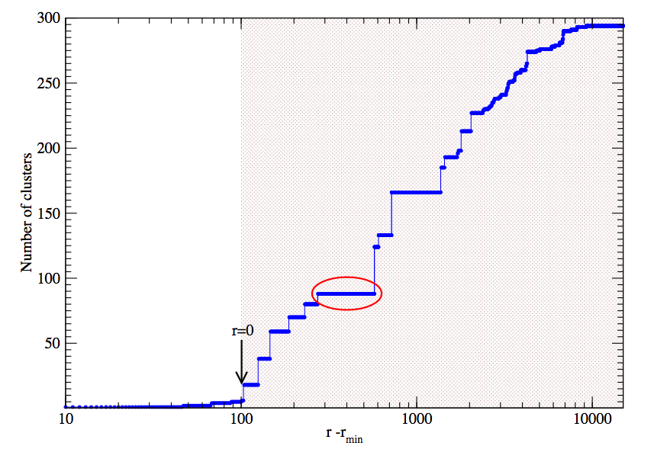
Outline & Summary
What is community detection and why is it useful?
How do you calculate communities?
Software links
Importance of resolution parameters
Multilayer networks

Slide 24

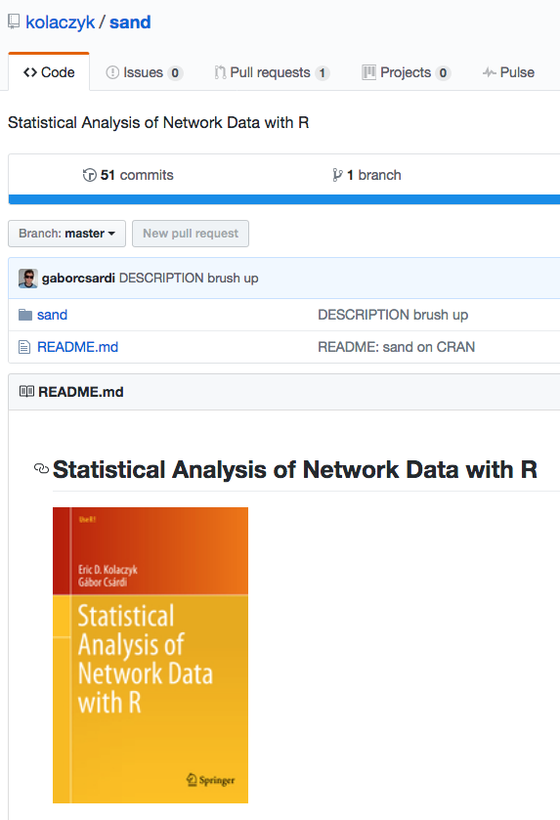
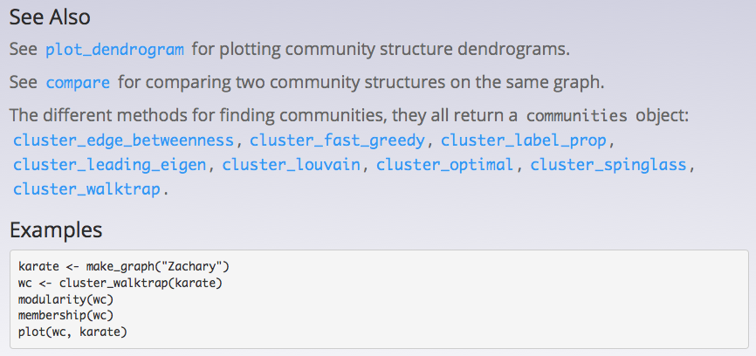
Software
Other great codes to know:
http://www.mapequation.org/
https://graph-tool.skewed.de/
https://github.com/vtraag/louvain-igraph
http://netwiki.amath.unc.edu/GenLouvain

Slide 25
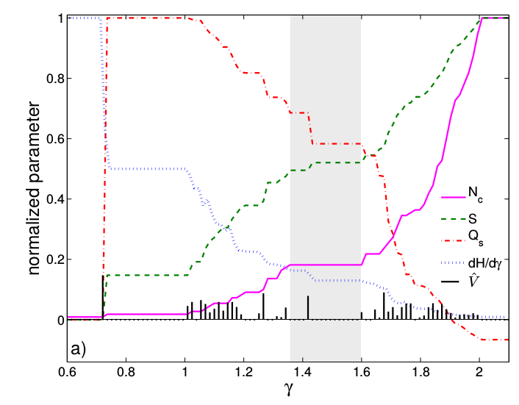
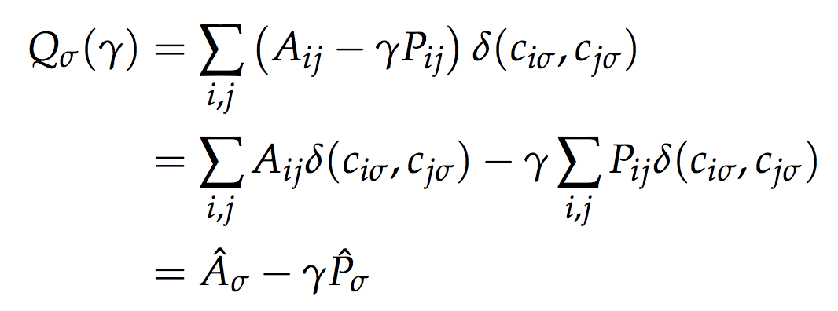
Recall the (pesky) resolution parameter?
Fenn et al., “Dynamic Communities in
Multichannel Data: An Application to the
Foreign Exchange Market During the
2007-2008 Credit Crisis” (2009)

Slide 26
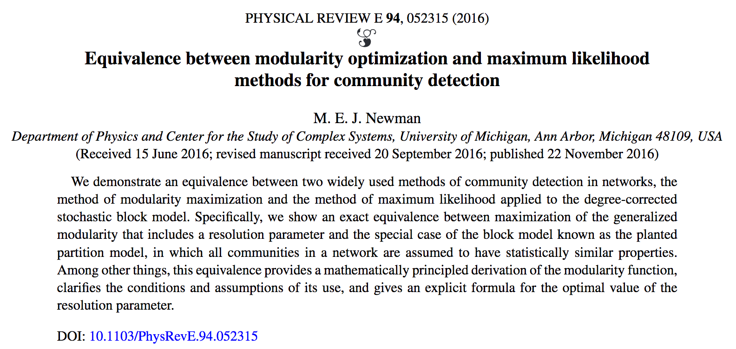
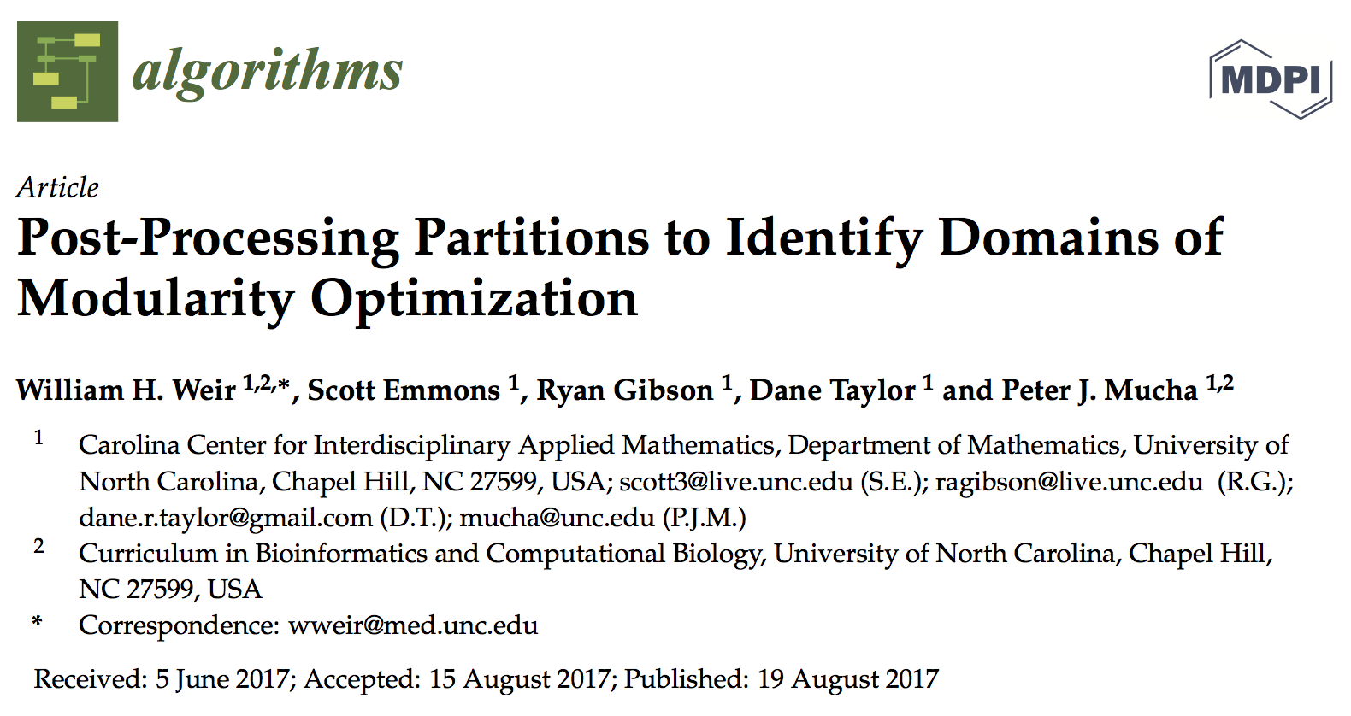
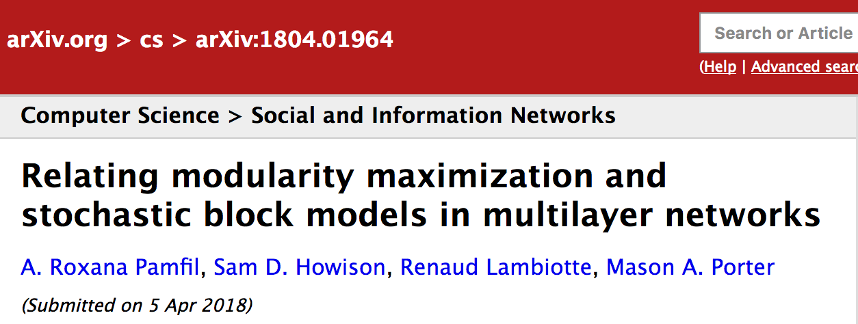
Picking resolution parameters still active research
https://github.com/wweir827/CHAMP

Slide 27
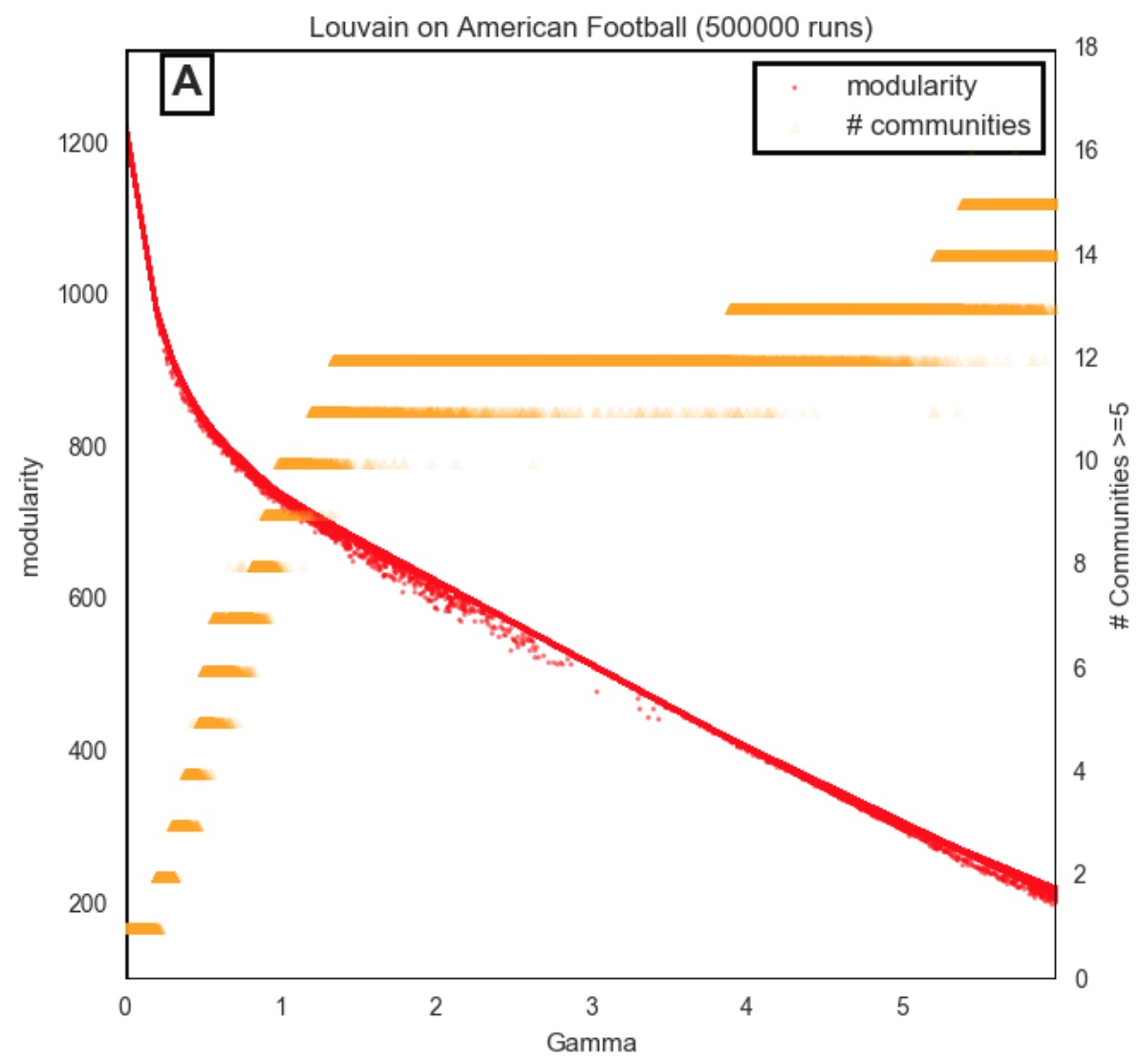
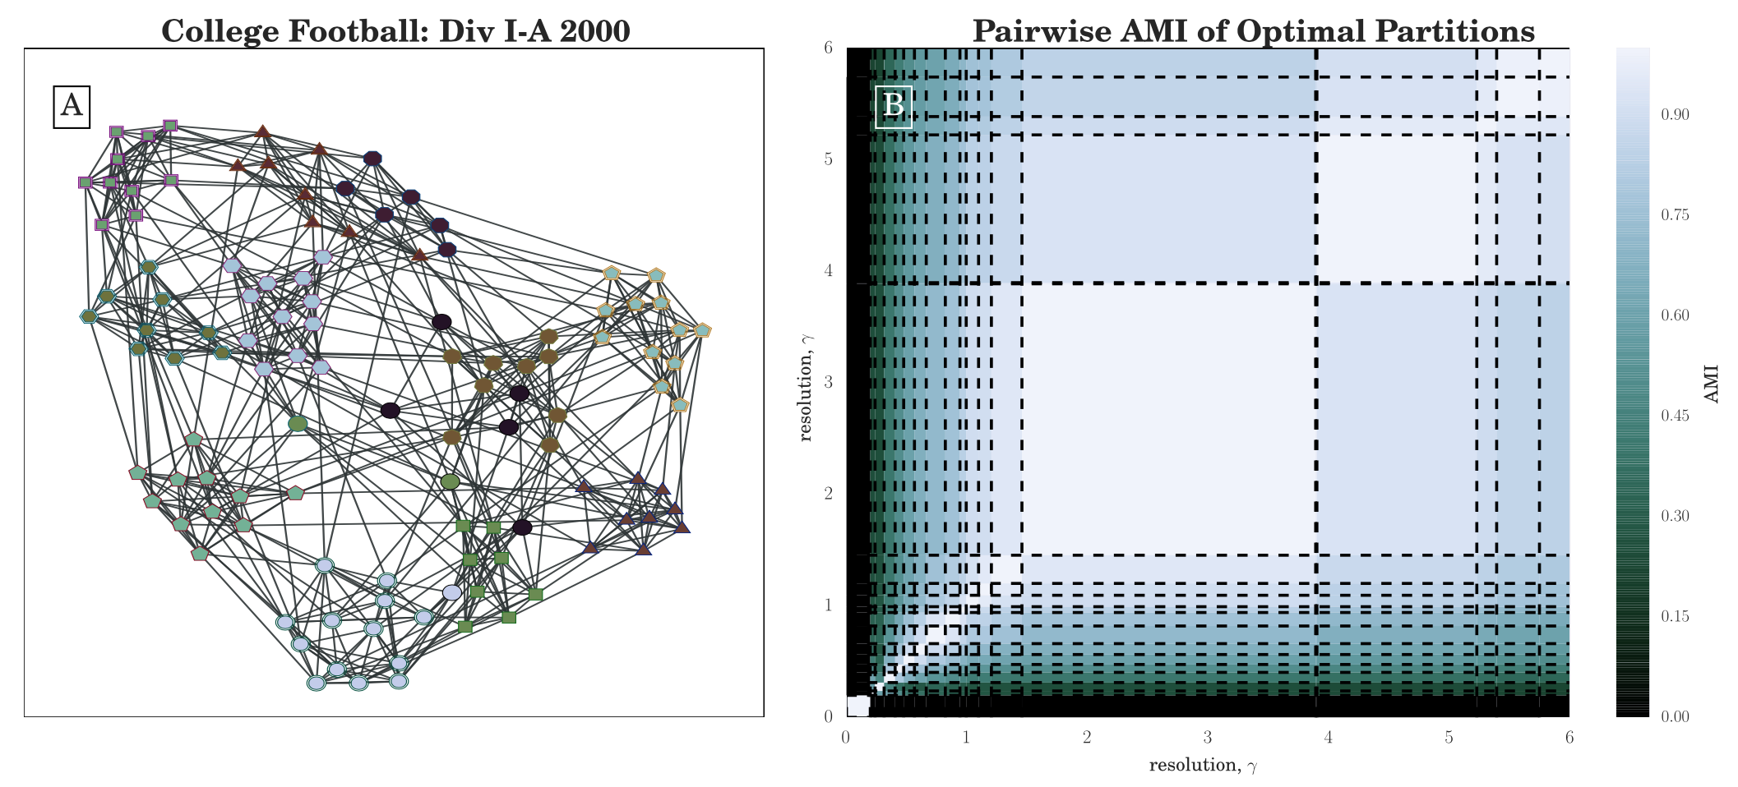
“Division I-A” College Football
50,000 Louvain calls
384 unique partitions

Slide 28
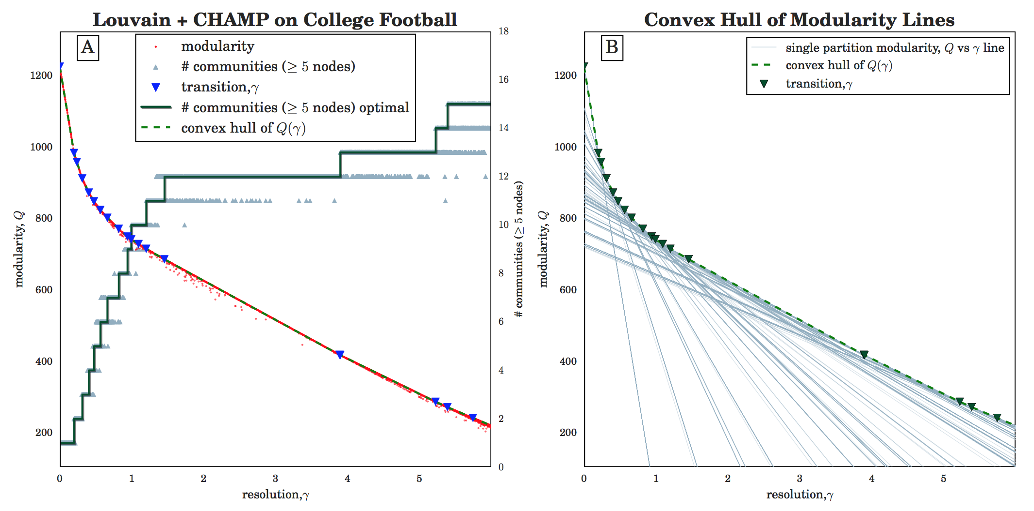
But Q_{σ}(γ) isn’t a point; it’s a line for partition σ
50,000 Louvain calls
384 unique partitions

Slide 29
But Q_{σ}(γ) isn’t a point; it’s a line for partition σ
50,000 Louvain calls
384 unique partitions
19 admissible partitions

Slide 30
Pairwise compare admissible partitions
50,000 Louvain calls
384 unique partitions
19 admissible partitions

Slide 31
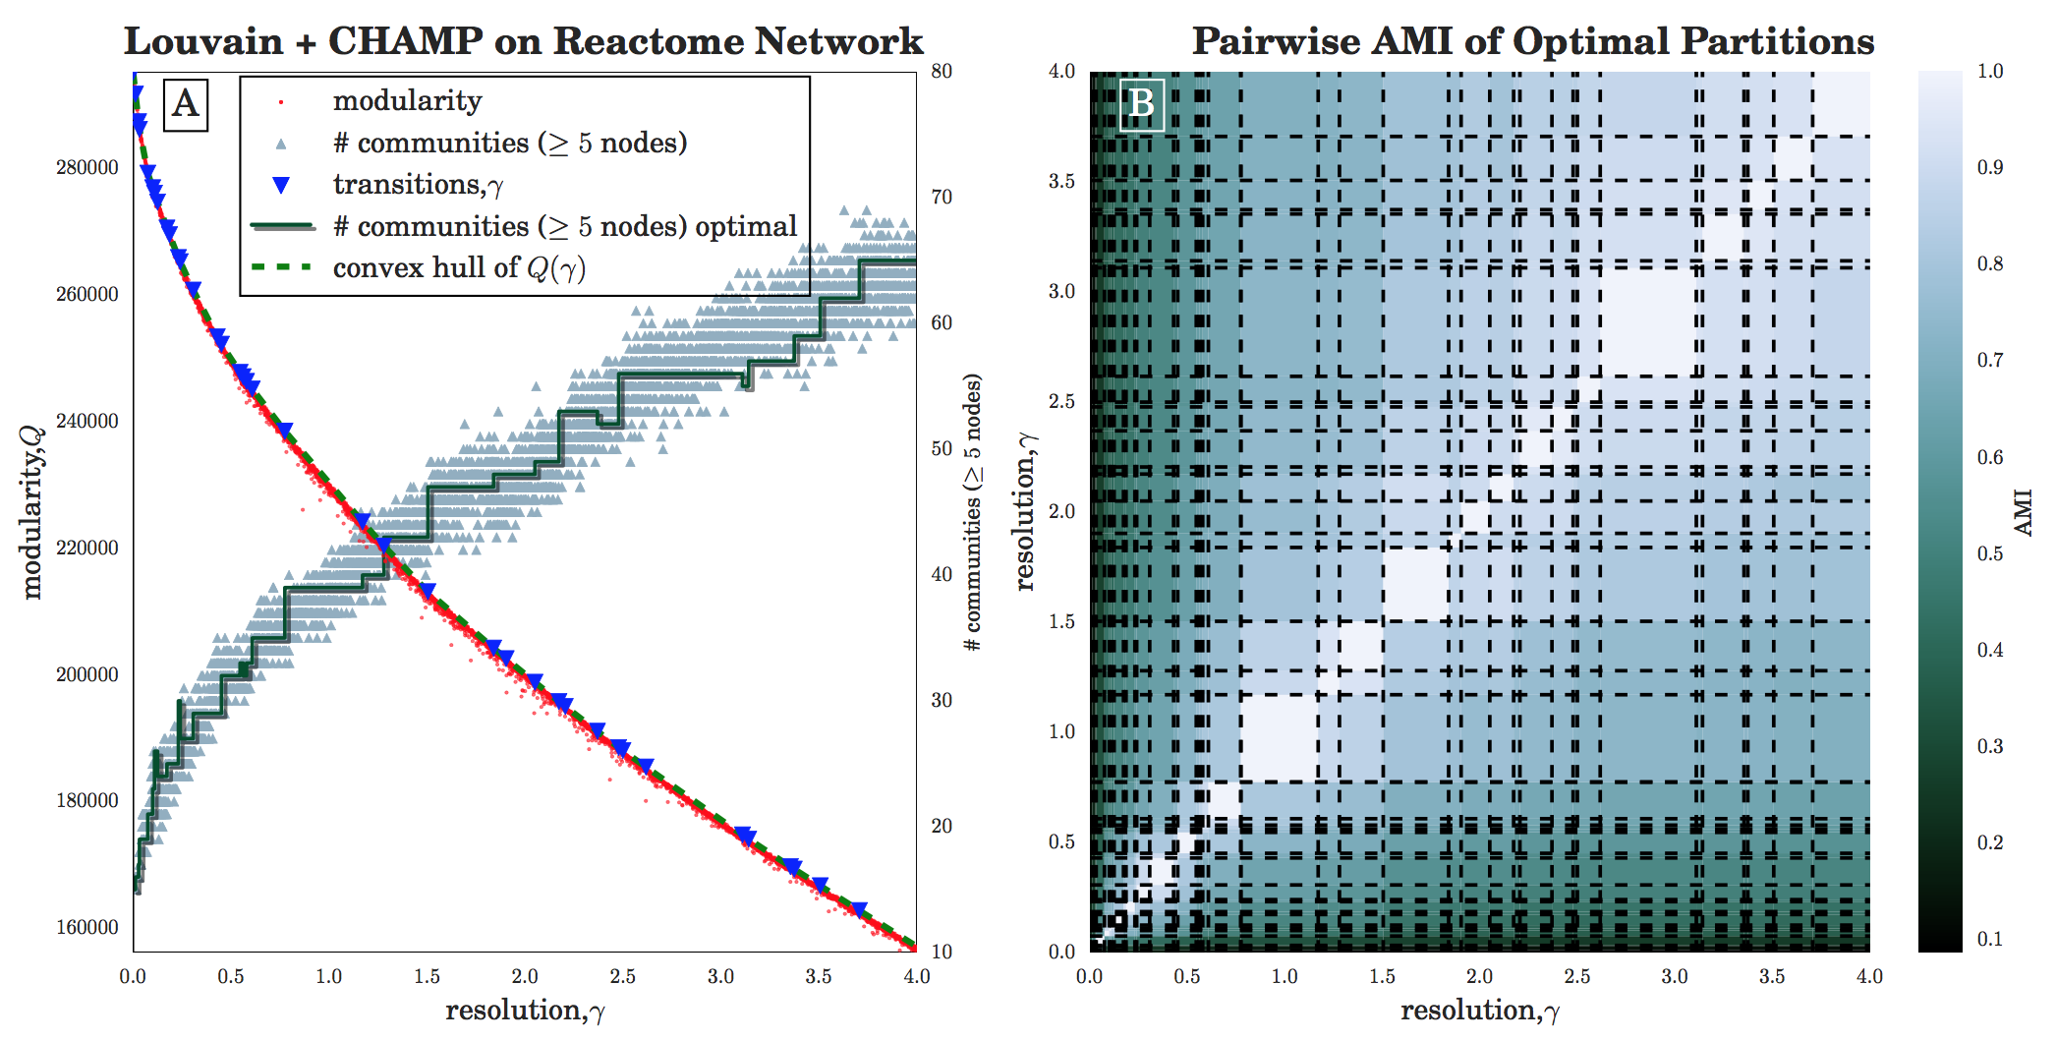
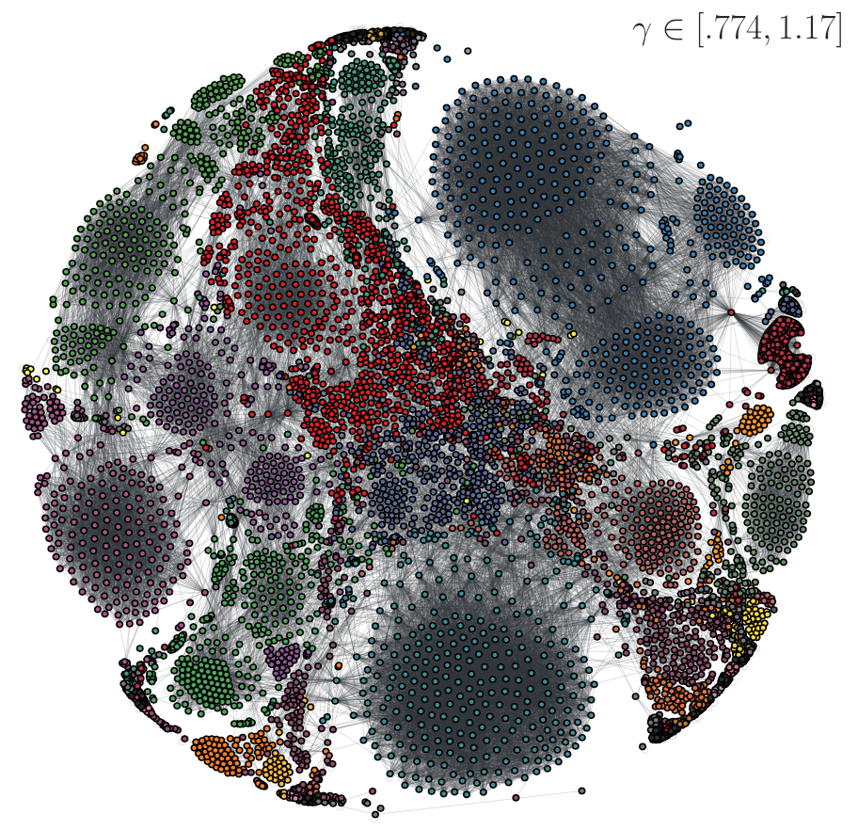
Human Protein Reactome
20,000 calls
19,980 unique
39 admissible

Slide 32
Human Protein Reactome
20,000 calls
19,980 unique
39 admissible

Slide 33
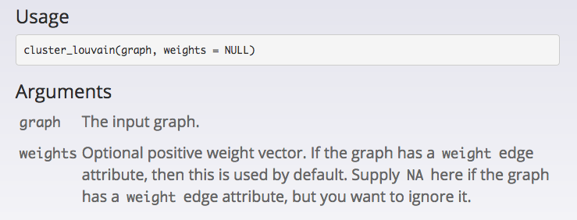
Self loops of weight r as a form of resolution parameter Arenas et al., “Analysis of the structure of complex networks at different resolution levels” (2008) (see also Shai et al., “Case studies in network community detection,” 2017)

Slide 34
Outline & Summary
Networks appear in many disciplines
Network representations provide a flexible framework for studying general data types, leveraging methods of social network analysis and network science.
Community detection is a powerful tool for exploring and understanding network structures, including multilayer networks.
Network structures identify essential features for modeling and understanding data in applications.
What is community detection and why is it useful?
How do you calculate communities?
Software links
Importance of resolution parameters
Multilayer networks
We are surely out of time… If we had more time, we would talk a lot about the refs in the following slides

Slide 35
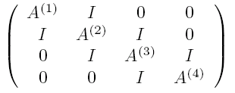
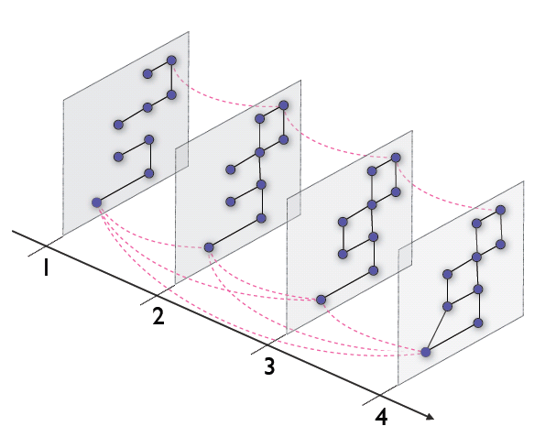
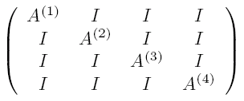
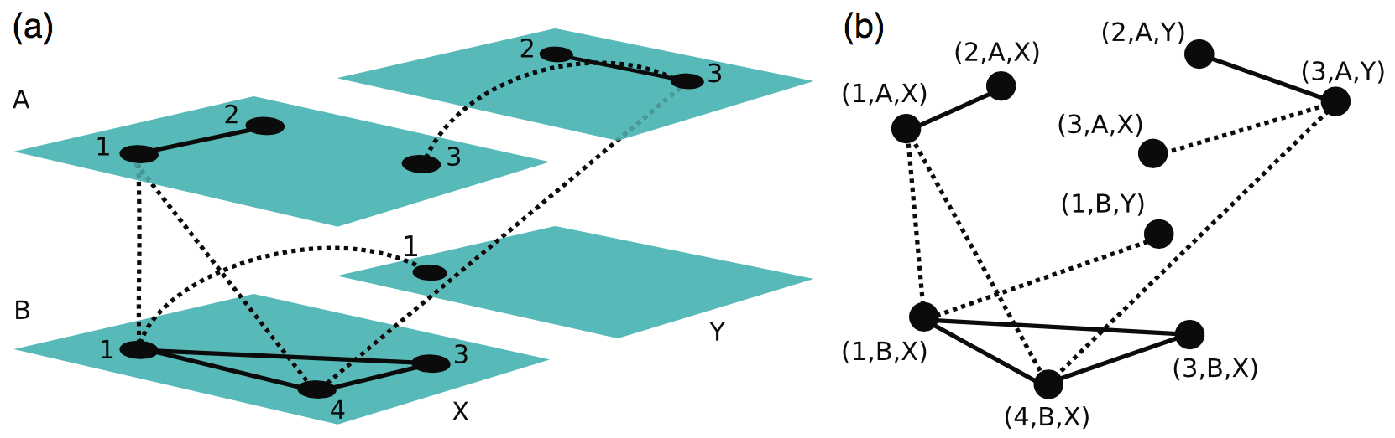
Multilayer Networks
Ordered
Mucha et al., “Community structure in time-dependent, multiscale, and multiplex networks” (2010)
Categorical
Kivelä et al., “Multilayer Networks” (2014)

Slide 36
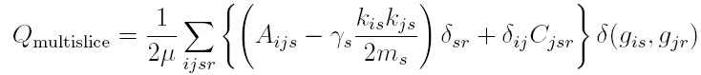
Multilayer Modularity
Mucha et al., “Community structure in time-dependent, multiscale, and multiplex networks” (2010)
How to count the expected weights of interlayer arcs given that they are definitional to the data structure?
Generalized Lambiotte et al. (2008) connection between modularity and autocorrelation under Laplacian dynamics to re-derive null models for bipartite (Barber), directed (Leicht-Newman), and signed (Traag et al.) networks, specified in terms of one-step conditional probabilities
intra-layer
adjacency data and null
inter-layer
identity arcs
Same formalism works for more general multilayer networks, with sum over inter-layer connections within same community

Slide 37
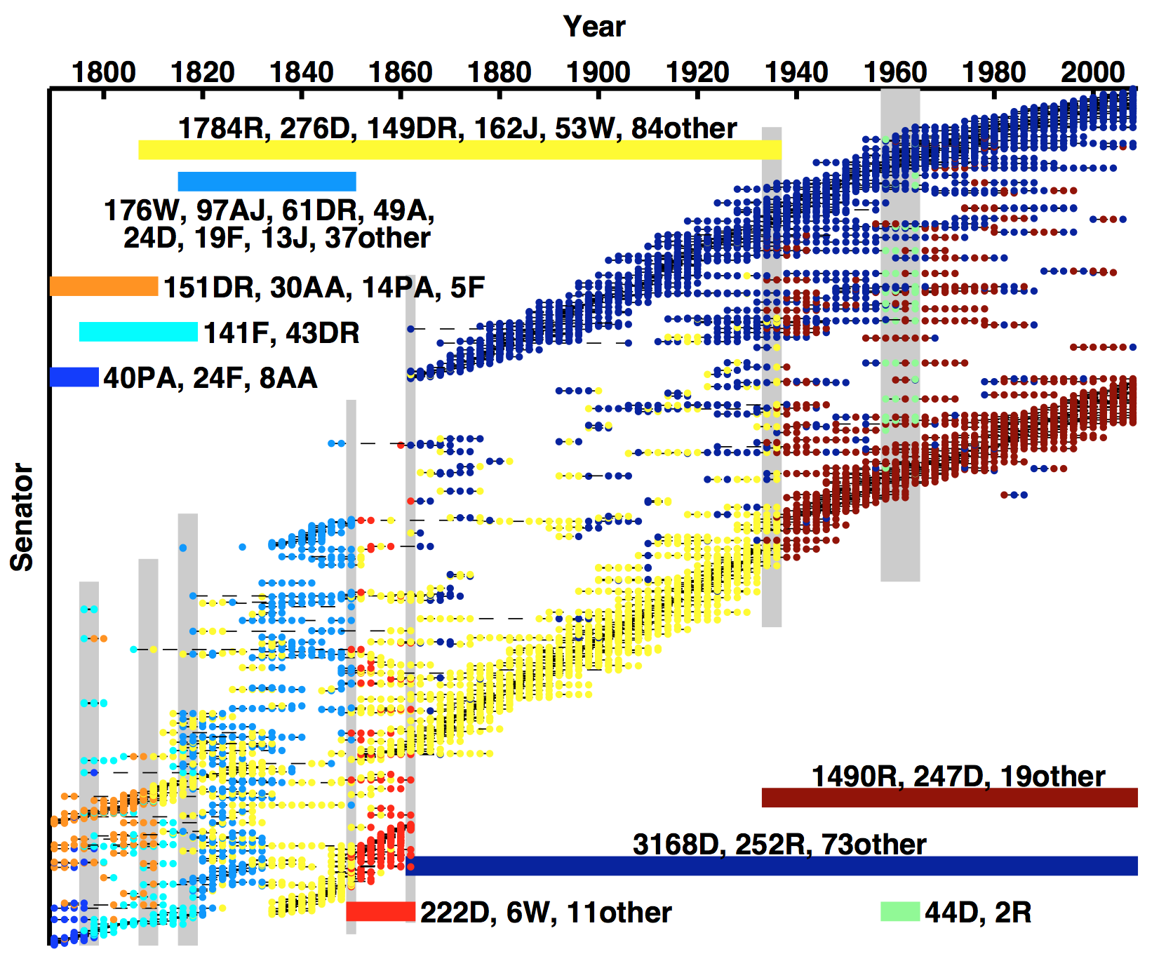
U.S. Senators across 2-year Congresses Mucha et al., “Community structure in time-dependent, multiscale, and multiplex networks” (2010)
Each point is a Senator in a Congress
Colored bars indicate temporal extent of each community, labeled by
nominal party labels
Grey bars indicate Congresses including more than two communities

Slide 38
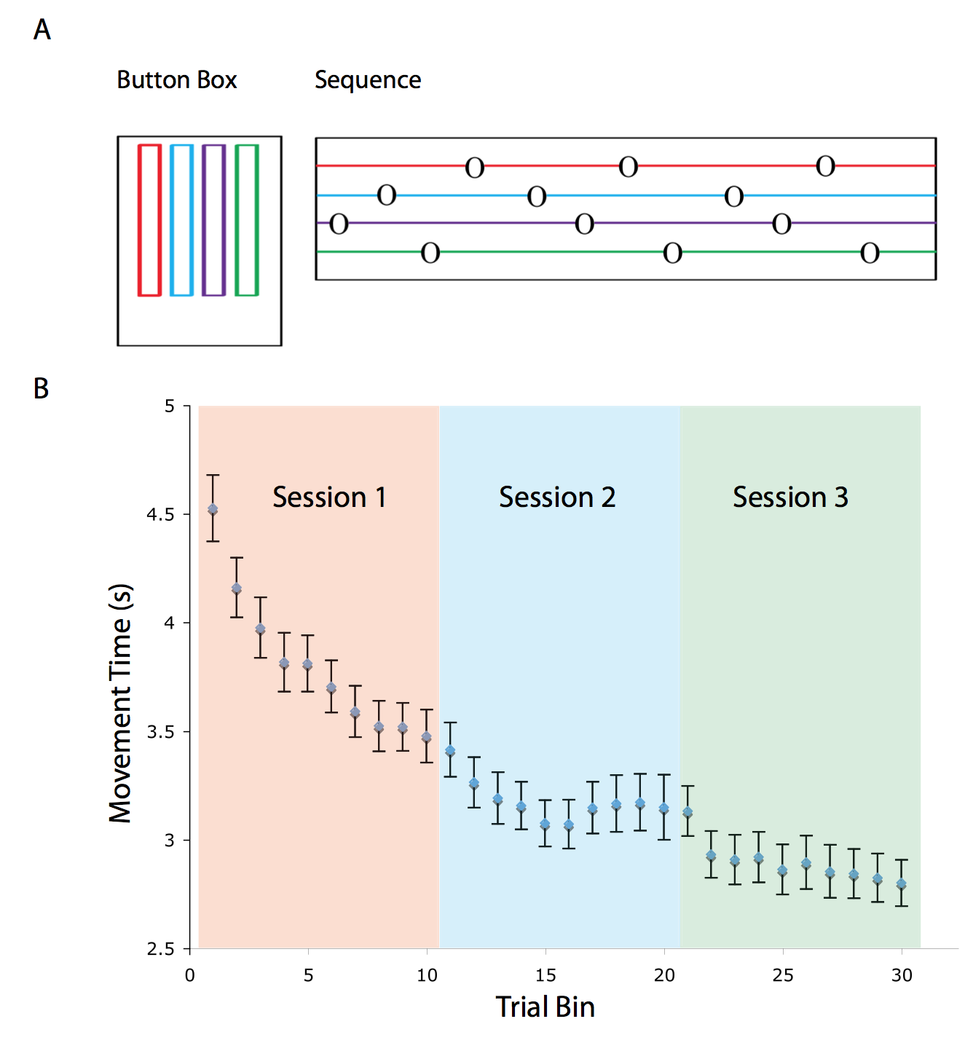
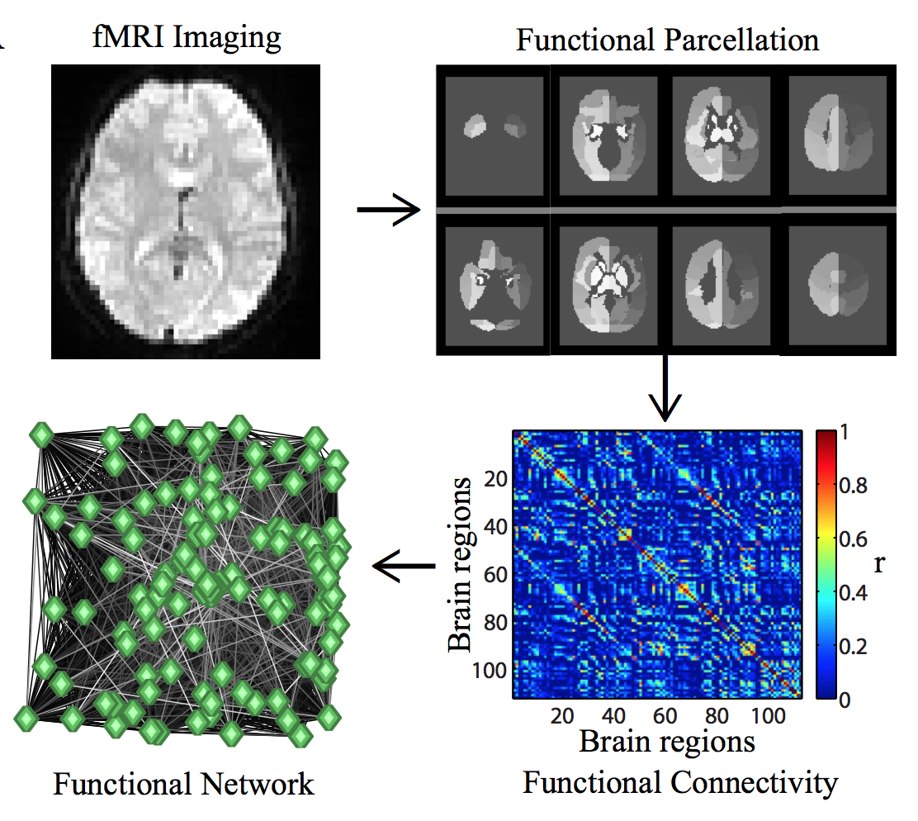
Bassett et al. “Dynamic reconfiguration of human brain networks during learning” (2011)

Slide 39

Cranmer et al., “Kantian fractionalization predicts the conflict propensity of the international system” (2015)
Identified communities of nation states in multiplex international relations of trade, IGOs, democracies
Granger causal relationship to total system-level conflict
Negligible contribution from joint democracy layer

Slide 40





See mapequation.org
Phys. Rev. X 6, 011036 (2016)

Slide 41

Stanley et al., “Clustering network layers with the strata multilayer stochastic block model” (2016)

Slide 42


Stanley et al., “Clustering network layers with the strata multilayer stochastic block model” (2016)

Slide 43

Stanley et al., “Clustering network layers with the strata multilayer stochastic block model” (2016)

Slide 44






Taylor et al., “Enhanced detectability of community structure in multilayer networks through layer aggregation” (2016)

Slide 45

Taylor et al., “Enhanced detectability of community structure in multilayer networks through layer aggregation” (2016)

Slide 46



Multilayer CHAMP (Weir et al., 2017)

Slide 47


U.S. Senate Roll Call Similarities (Congresses 1-110)
240,000 GenLouvain calls; 197,879 unique partitions; 1,447 admissible partitions

Slide 48
Community Detection Firehose Overview
“Hard/rigid” v. “soft/overlapping” clusters
cf. biclustering methods and mathematics of expander graphs
A community should describe a “cohesive group”: varying formulations/algorithms
Linkage clustering (average, single), local clustering coefficients, betweeness (geodesic, random walk), spectral, conductance,…
Classic approach in CS: Spectral Graph Partitioning
Need to specify number of communities sought
Conductance
MDL, Infomap, OSLOM, … (many other things I’ve missed) …
Stochastic Block Models: generative with in/out probabilities between labeled groups
Modularity: a good partition has more total intra-community edge weight than one would expect at random (but according to what model?)
“Communities in Networks,” M. A. Porter, J.-P. Onnela & P. J. Mucha,
Notices of the American Mathematical Society 56, 1082-97 & 1164-6 (2009).
“Community Detection in Graphs,” S. Fortunato, Physics Reports 486, 75-174 (2010).
“Community detection in networks: A user guide,” S. Fortunato & D. Hric, Physics Reports 659, 1-44 (2016).
“Case studies in network community detection,” S. Shai, N. Stanley, C. Granell, D. Taylor & P. J. Mucha, arXiv:1705.02305.

Slide 49
Outline & Summary
Networks appear in many disciplines
Network representations provide a flexible framework for studying general data types, leveraging methods of social network analysis and network science.
Community detection is a powerful tool for exploring and understanding network structures, including multilayer networks.
Network structures identify essential features for modeling and understanding data in applications.
What is community detection and why is it useful?
How do you calculate communities?
Software links
Importance of resolution parameters
Multilayer networks

